Slide 1


Rectifier
CODE KRAKEN
HILL IRRIGATION OPTIMIZER
Aayushi Koshti
Manav Rachna University

Slide 2
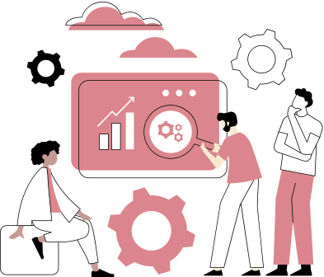
About The Project
The primary goal of this project is to develop a software framework that enables the efficient operation of water pumping systems in remote hilly areas where access to a reliable power source is limited.
Access to clean and reliable water sources is critical for the well-being of communities. By optimizing water pumping systems, this project aims to ensure a sustainable and uninterrupted supply of water.
Page 01

Slide 3
Problems Targeted
01
Inadequate Access to Clean Water
04
Resilience to Climate Change
02
Reliance on Manual Labor and Energy
05
Health and Hygiene
03
Environmental Sustainability and Community Development
Page 02

Slide 4

Features
The core of the project is the development of intelligent algorithms that can optimize energy usage based on factors such as water availability, budget, water demand, and system efficiency.
01
The software framework includes remote monitoring and control capabilities, allowing operators to oversee system performance and make adjustments as needed through a user-friendly interface.
02
Page 03

Slide 5
TECH STACK
PYTHON
TKINTER
PYINSTALLER
Page 04

Slide 6
Concepts Used
Threading
File Handling
Optimization
Page 05

Slide 7
Process
Step 1
Step 2
Step 3
Enter the information regarding the site
Enter your budget and irrigation quantity required
Get the optimized result on the factors of most effective, cheapest and fastest
Page 6

Slide 8
Presentation
CODE KRAKEN
THANK YOU
For Your Attention
Team Rectifier

